Slide 1


5 days R programming training
Madan Bhandari Academy of Health Science
Hetauda-10, Nepal
21.01.2082-25.01.2082

Slide 2

ABOUT US :
Dr. Sampurna Kakchapati
Research Manager, Herd International
Er. Shirish Maharjan
Senior Data Officer (Data Analysis and Visualization), Herd International
https://herdint.com/

Slide 3
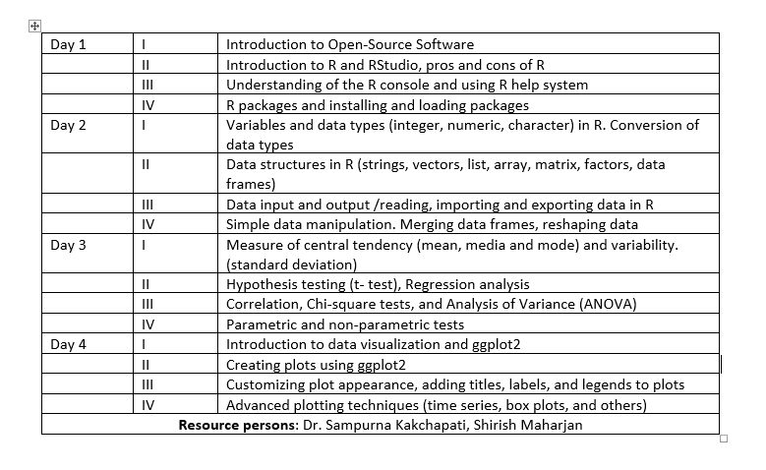

Slide 4
3 days training expectations
Go to www.menti.com
CODE : 48279110

Slide 5
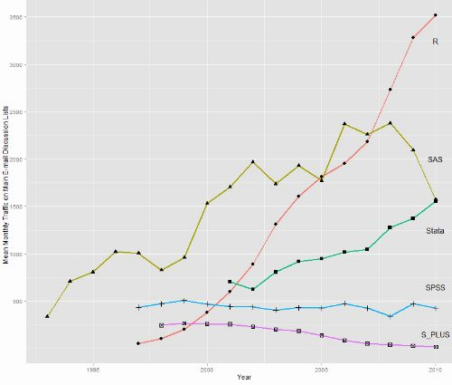
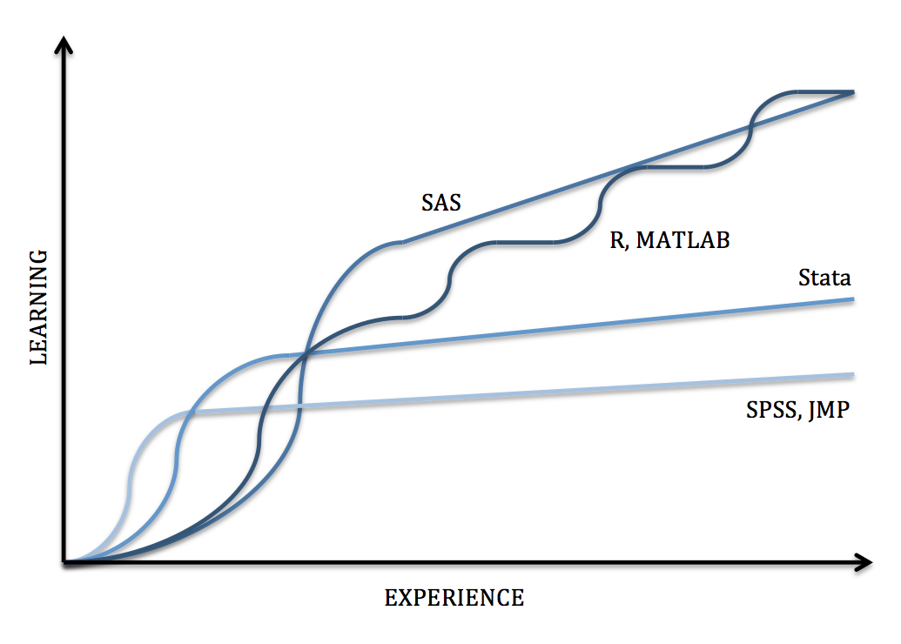
Learning curve of R programming.

Slide 6
Objectives of this training
To introduce the basic concepts of R Programming for data management, modeling, handling, analysis, visualization and presentation.
Course Expected Learning Outcomes:
The participant will learn data types, data imports/export, basic graphs, basic statistics, regression, time series data visualization techniques.
They will know how to access, clean, annotate, summarize, visualize, and model datasets and prepare results in publication quality, tables, graphs, word and pdf type document.
They will learn how to handle real world data and R packages used in forest analysis such as ForestTools, vegan, lidR and more.
Participants will know where to find resources to continue learning, and are able to evaluate the potential use and limitations of R for their own projects

Slide 7
Tentative training objectives
Accessing the data (getting the data into the application from multiple sources like csv, excel, raster etc.)
Cleaning the data (coding missing data, fixing or deleting miscoded data, transforming variables into more useful formats using tidyverser, dplyr)
Annotating the data (in order to remember what each piece represents using reshape)
Summarizing the data (getting descriptive statistics to help characterize the data using summary function.)
Visualizing the data (because a picture really is worth a thousand words using ggplot2)
Modeling the data (uncovering relationships and testing hypotheses, parametric and nonparametric)
Preparing the results (creating publication-quality tables and graphs using ggsave, R markdown knit option)

Slide 8
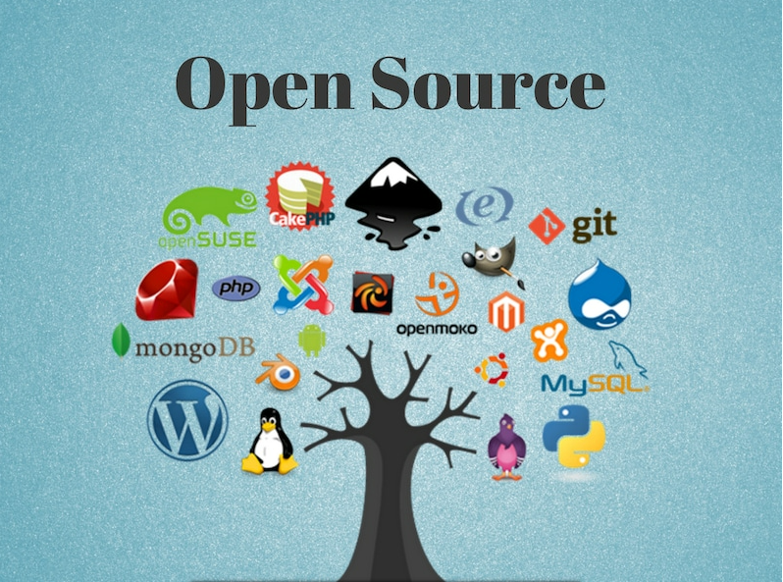
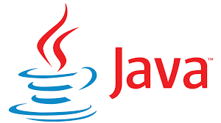





Introduction to Open source Software

Slide 9
What is open-source software?
Open-source software is non-proprietary software that allows anyone to modify, enhance, or simply view the source code behind it. It can enable programmers to work or collaborate on projects created by different teams, companies, and organizations.
Open-source software authors do not view their creations as proprietary and instead release their software under licenses that grant users with the desire and know-how to view, copy, learn, alter, and share its code.
Open source doesn’t just mean “free”. Lots of companies release their software for free but maintain full copyright ownership of their code, so other developers aren’t able to modify it.
Successful open source initiatives are built on the hard work of potentially thousands of collaborators who have voluntarily given up their time to create something awesome. (e.g. R and QGIS). R has more than 18,000 packages developed by its community

Slide 10
Open-source software is non-proprietary software that can allow for collaboration and modification among developers.
Popular open-source software applications include Mozilla Firefox, LibreOffice, and VLC Media Player.
NOTE ::: While many application creators keep the secrets of their technology under lock and key, open-source software (OSS) takes the exact opposite approach, encouraging collaboration, transparency, and community development.

Slide 11
Advantages of open-source software
Open-source software tends to be more flexible as it offers programmers multiple ways of solving problems and encouraging creative solutions.
Improvements and bug fixes on OSS happen much more quickly. Because open-source software allows collaboration, issues and improvements are implemented at a faster pace.
It's cost-effective. Generally speaking, proprietary software requires internal employees to work on its source code to keep the information private. Open-source software allows those unaffiliated with the project access without its authors having to pay out for further development.
You can attract better talent. If a small business launches open-source software, the ability of all programmers to view and modify it could allow the organization to recruit particularly talented employees.
It is under constant development with new procedures added daily.

Slide 12
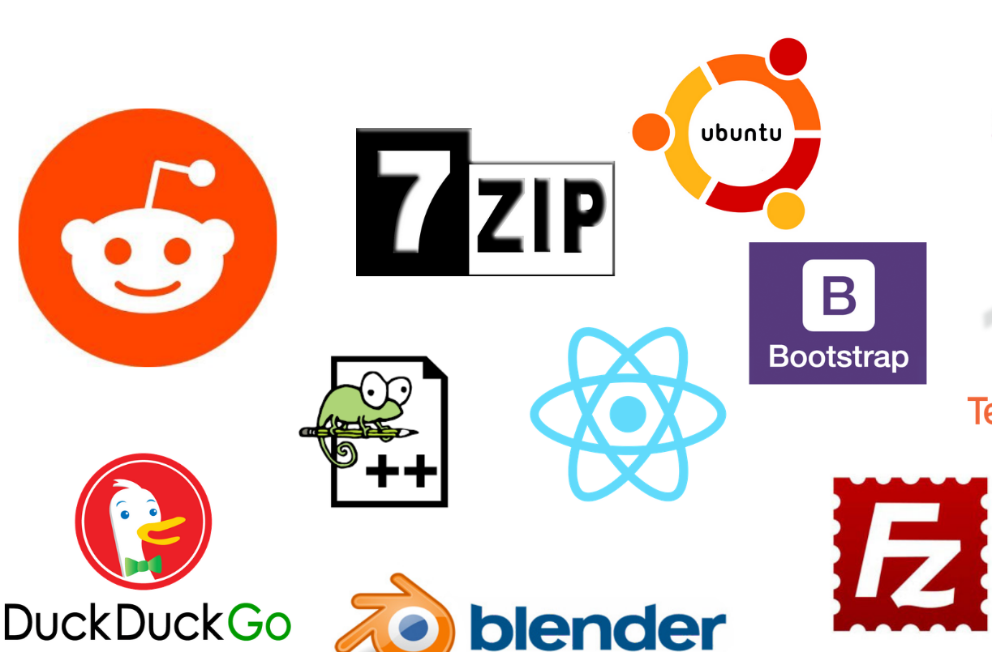
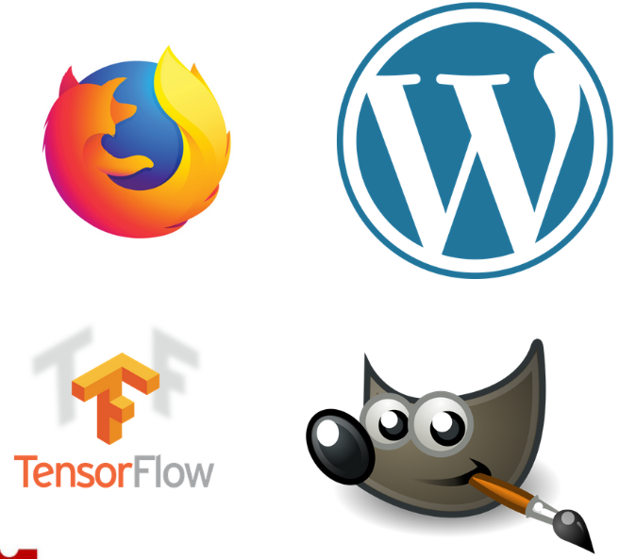
Open Source Alternatives to Proprietary Software

Slide 13
